Slide 1


2024 - 2025Title I Annual Parent Meeting
Azalea Elementary
8/28/24
5:00pm – 7:00pm
Azalea Elementary - Classrooms
Michael Rebman
Notes:
Evidence: Upload completed presentation and recorded feedback as part of the evidence to support the Annual Meeting Materials. Do not forget the sign-in sheets, and survey/feedback that you receive throughout the meeting.

Slide 2
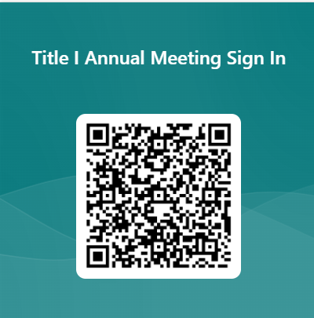

Azalea Elementary Title l Annual Meeting
2024-25

Slide 3


How did we develop our Title I Plan?
Comprehensive Needs Assessment
School Improvement Plan
District Climate Survey (Title l Items)
PM3 Data/Connection to Phase lll
Notes:
Calling out some data sources to get them started…

Slide 4


All About Title l
Title I is the largest federal assistance program for our nation’s schools.
The program serves 99 schools in Pinellas County including eligible students in 39 non-public schools.
The Title l goal is that every student achieves high levels of academic proficiency.
Notes:
Highlight the Title l Program here in Pinellas County.

Slide 5

Title I Funding Process
2. Florida Department of Education
1. Federal Government
Azalea Elementary
3. Pinellas County Schools
Notes:
The Florida Department of Education receives funds from the federal government. Districts receive Title I funds from Department of Education, and the school district distributes these funds to schools based on the percentage of children eligible for free/reduced price lunch; however, students do not have to be from low-income families to receive help.

Slide 6


Title l Supplemental Resources
Definition: provided in addition to what is already present or available to compete or enhance it
Notes:
Definition: provided in addition to what is already present or available to complete or enhance it extra academic support and learning opportunities for economically disadvantaged students.

Slide 7
Title I Programs Provide Supplemental Support
Supplemental Resource | Positive Impact
Additional supplemental personnel (Hourly Teachers and Paraprofessionals) | Direct Instruction, 1-on-1 and small group to grow student reading skills
Additional training opportunities for school staff | Professional development in Math and Reading for teachers
Extended Learning Opportunities (before and/or after school programs) | Promise Time, and Enrichment Clubs to develop all student domains (Academics, Personal/ Social)
Parent and Family Engagement Resources and Training Workshops | Fall and Spring Events with academic focus
Supplemental teaching materials, equipment, and technology | ALL students in Reading, Writing and Math
Notes:
Use additional slides if necessary. This is where you want to really highlight Title I funding and how it positively impacts your scholars! Additional supplemental personnel (add specific positions)
If there are connections that they can make, they call it out!

Slide 8


Slide 9
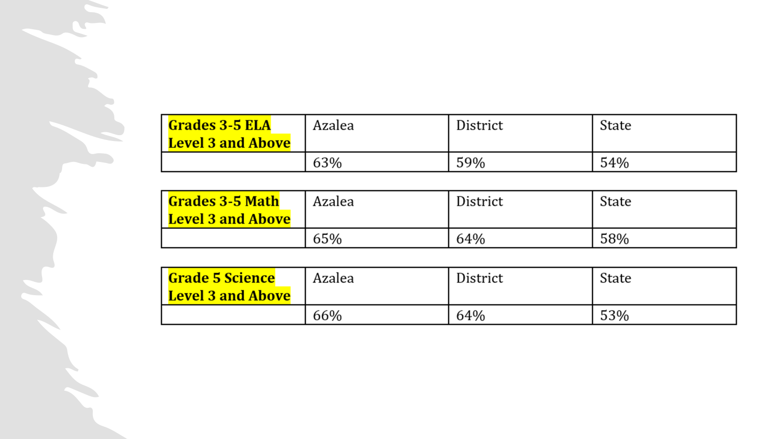
Let’s Celebrate!
Notes:
Based on the FAST data and school grades, there is a lot to celebrate!!
How did your Title I Resources support or enhance the work that you were able to get done?

Slide 10
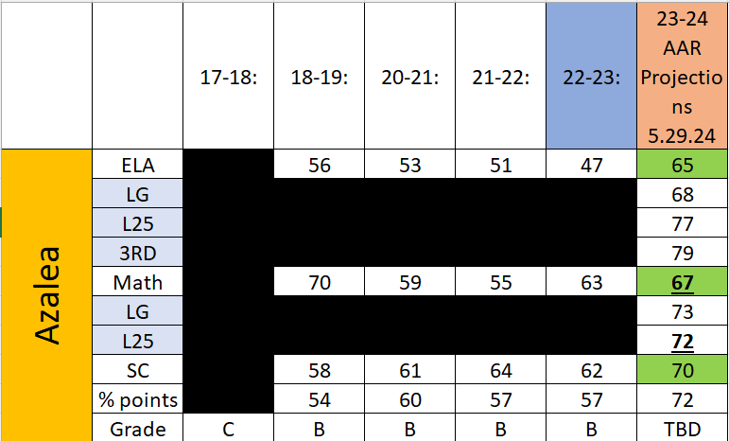
Notes:
“There are no high performing schools without great cultures. They don’t exist.” ~Ron Large
NO subgroups under 41%
Black – 44%
ESE – 51%
EL – 50%

Slide 11
Title I Schoolwide Planning and Input
First
Second
Last
Seek Input from school, family, and community members determine how Title I funds are used based on a needs assessment.
Please attend online or in-person meetings/trainings and complete surveys to provide input on Title I funding.
All Title I schools must document that parents are involved in the schoolwide planning process.
Notes:
Evidence for input – input from school can be a survey or notes, which include quotes related to what was shared as feedback AND how this input will be used to inform the PFEP and future engagement activities.
Evidence of Attendance – please include attendance of DIVERSE stakeholder group/s.

Slide 12

Title I Schoolwide Budget
Azalea Elementary is provided $91,575 to pay for supplemental resources and programs for increased student achievement.
$78,275 – hourly teachers and paraprofessionals to support skill deficit services
$13,300 – instructional materials and i-Ready Math
$5,600 – family engagement (family community liaison, instructional materials, central printing, food for family events)

Slide 13

Parent’s Right to Know
As a parent of a student attending a Pinellas County School Public School, you have the right to…
Be
Be provided information on your child’s level of achievement on assessments in Reading/Language Arts, Writing, Mathematics, and Science.
Request and receive information on the qualifications of your child’s teacher and supplemental personnel working with your child.
Be
Be notified of non-highly qualified or out-of-field teachers at the school.
Be
Be informed if your child is taught by a non-highly qualified teacher for four or more consecutive weeks.

Slide 14
Working Together for Student Success
School
School Improvement Plan (SIP)
Title
Title I Schoolwide Plan
Parent
Parent and Family Engagement Plan
School
School-Parent-Student Compact
Title l is now included as a part of the School Improvement Plan
Notes:
As a Title I parent you have the right to be involved in the development of the following plans and documents for our school which can be found on our website (insert website) to view as well as in the Parent Station located (insert location here).
Our school’s Title I Parent Station is located (insert location or photo of Title I Parent Station (front office and on the webpage). Please include photo as part of the evidence monitoring.
You will find a copy of our School Improvement Plan, Title I Schoolwide Plan, School’s PFEP, the School District’s PFEP, Parent’s Right to Know Memo, Upcoming Events, Compact, (insert other documents at your station)
School Improvement Plan (SIP)
Parent and Family Engagement Plan
Title I Schoolwide Plan
School-Parent-Student Compact

Slide 15

Parent-School-Student Compact
The purpose of the compact is to foster student achievement. By signing the Parent-School-Student Compact, (Insert name of school here), teachers, staff, parents and students agree to work together to share the responsibility of helping students meet or exceed state, district and school academic goals.
The Parent-School-Student Compact is updated every year to include parent, student, teacher, and staff input. Parent, student, teacher and staff comments are welcome at any time during the year.
Please review and sign your child’s Compact.
Our goal is to receive 100% signed compacts!
Notes:
At the elementary level, school compacts are used as a progress monitoring tool through the year during parent teacher conferences.

Slide 16
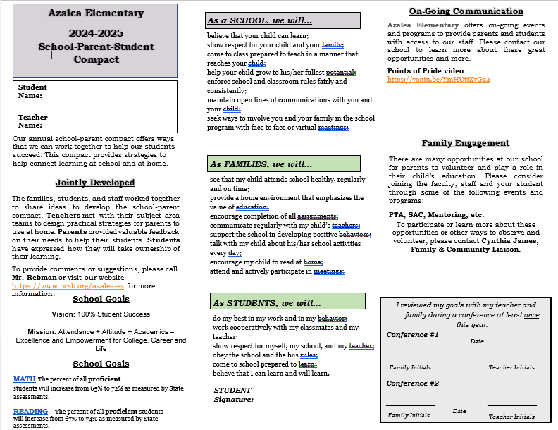
Sample School Compact
Notes:
Please insert the an example of your updated school compact. Highlight any things that unique to your school’s compact.

Slide 17

Parent and Family Engagement Plan (PFEP)
The PFEP Sections include information about the following:
  Parent trainings to increase student achievement
  Staff trainings for engaging parents
  Communication methods between home and school
  Flexible meeting times
  Accessibility for parents
  Coordinating with other Federal Programs
  To access the full LEA PFEP, please visit
  www.pcsb.org/titleone
Notes:
Specific meetings you can join
SAC – contact Mr. Rebman
PTA
APF
PAC

Slide 18


Florida Benchmark For Excellent Student Thinking Standards (B.E.S.T). You may read more information by visiting, www.fldoe.org.
Notes:
All curriculum, instruction and assessments are based on student-centered expectations.
Your child’s classroom teacher will share specifics regarding our core curriculum with you during the remainder of Back to School Night

Slide 19

  School Report Cards
  School Grade and Overview
  Population and Enrollment
  Assessments – Academic Achievement, Growth, and Population
  Assessments – English Language Learners
  Graduation and Beyond
  Educator Qualifications and Equity
  Long-Term Goals and Interim Progress
  Accelerated Course Enrollment
  Per-Pupil Expenditures
  National Data
  Available online at https://edudata.fldoe.org/ or Front Office

Slide 20

9/5 and 9/6 Grandparents Day Lunch
10/25 Trunk or Treat Fall Festival
10/31 Fall “Halloween” Parade
11/20 and 11/21 Thanksgiving Lunch
12/12 Disney themed STEAM Night
Notes:
Do you have a calendar of key events that are included in your PFEP.
Evidence – Consider this as evidence to include to support Family Engagement.

Slide 21
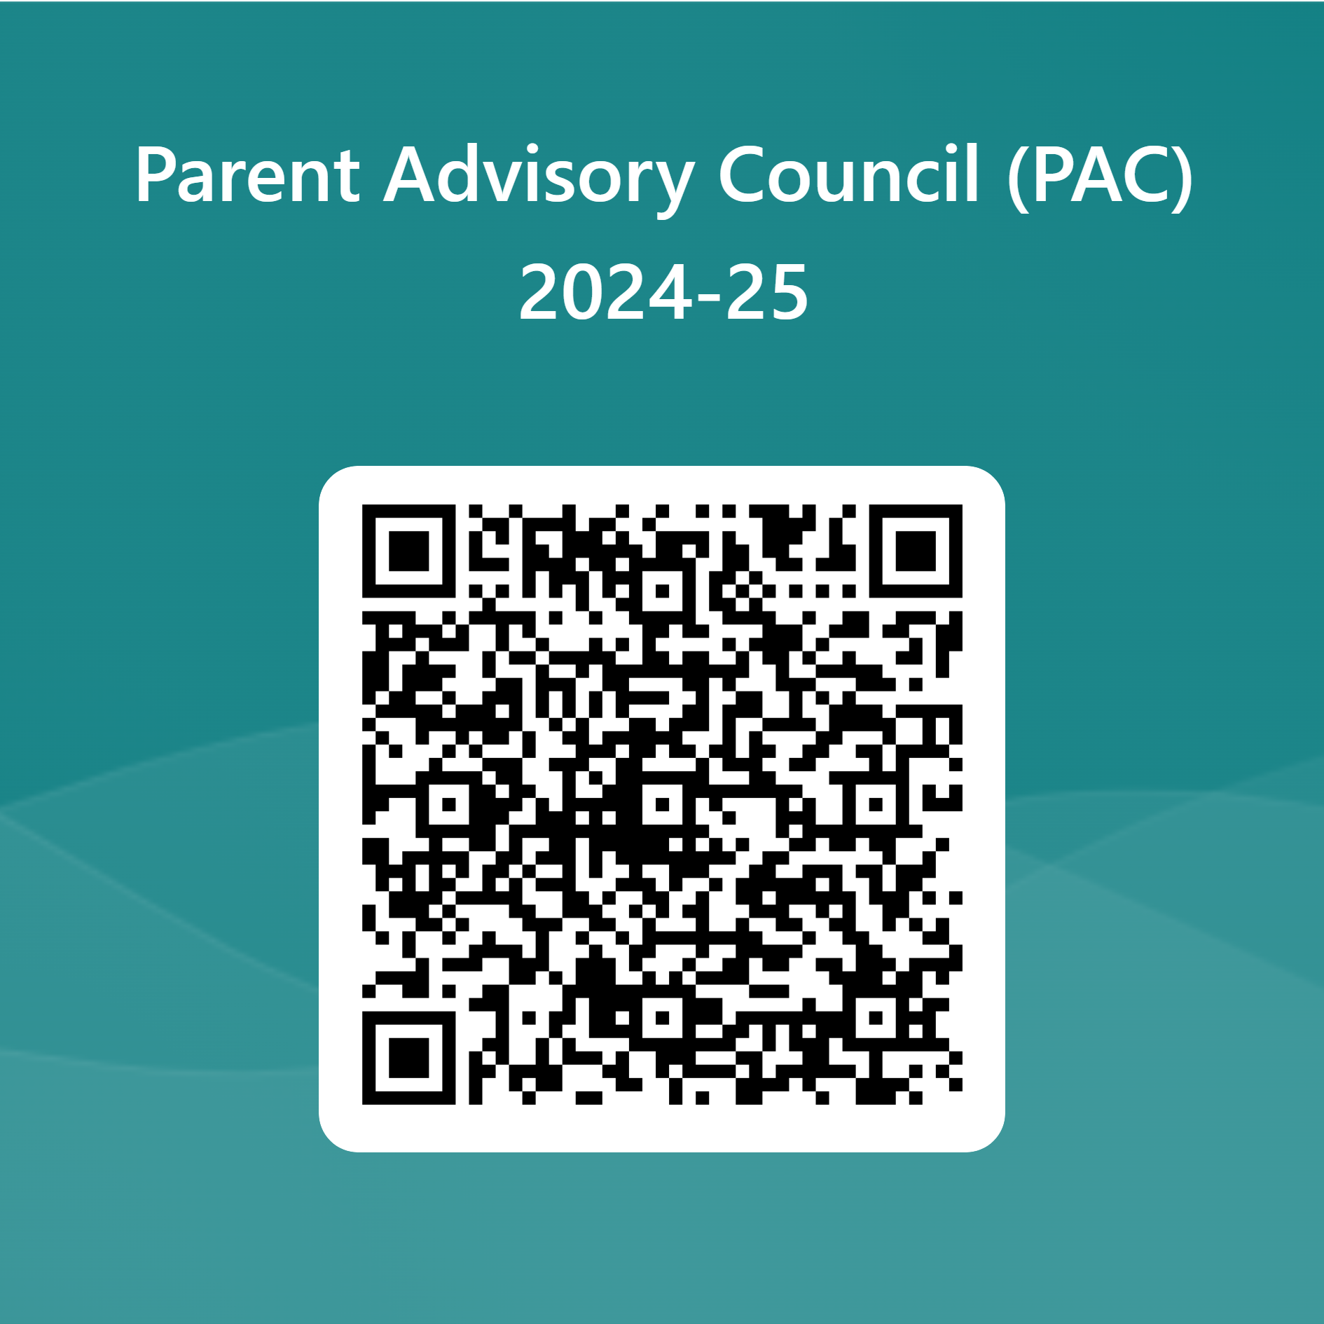

Parent Advisory Council (PAC)
The District has a Parent and Family Engagement Plan. The summary of the plan is in the Title I School & Family Partnership Overview.
You may access the full plan at www.pcsb.org/titleone
The Parent Advisory Council (PAC) is responsible for reviewing and revising the District PFEP.
PAC will meet virtually or in person with the district’s Title I staff.
Each school is committed to having at least one member representative in PAC.
PAC meets twice a year, if you are interested in representing our school please notify, Insert contact person
Notes:
Please add your PAC representative in slide and share with your Title I Specialist.
https://forms.office.com/r/r5daaMTENE\

Slide 22
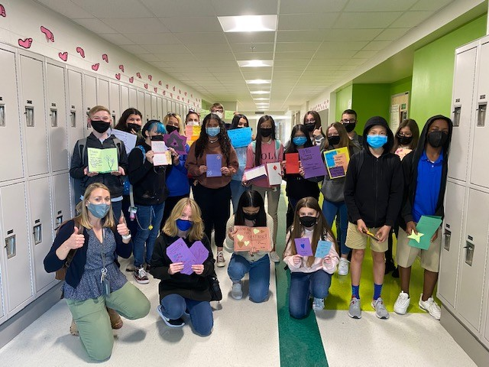

Additional Resources
Learning at Home Family Resources - https://www.pcsb.org/Page/32836
Volunteer in a Pinellas County School - https://www.pcsb.org/Page/459
Parent Academy POWER HOURS Webinars - https://www.pcsb.org/Page/26534
Partnerships - https://www.pcsb.org/Page/418

Slide 23

Thank you for your time!

Slide 24
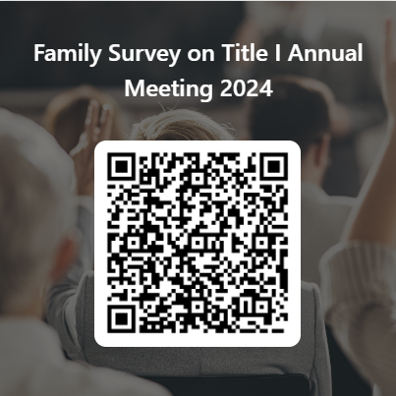
Please take the time to participate in our survey.
https://forms.office.com/Pages/ResponsePage.aspx?id=BZM8c9c5GkaGb_3ye_PH__MyqOG7_1BGjESbfG7aJY9UNlZJMkxRM1lKVlBYOUxPQThSTzlZQTUzMi4u
Your feedback is greatly appreciated!
Notes:
Please duplicate Microsoft Forms provided or create school survey. To generate a QR code hover over your school’s survey and and right click. Create QR code for this page will be an option.
https://forms.office.com/Pages/ShareFormPage.aspx?id=BZM8c9c5GkaGb_3ye_PH_x-1YNVO6C1FkgA88U6PR2tUNEQzTU0wNkZXVUxVTlpEMU81NkJFMlJNTi4u&sharetoken=FXXhmgwFjSnl0sNz61ki

